Slide 1
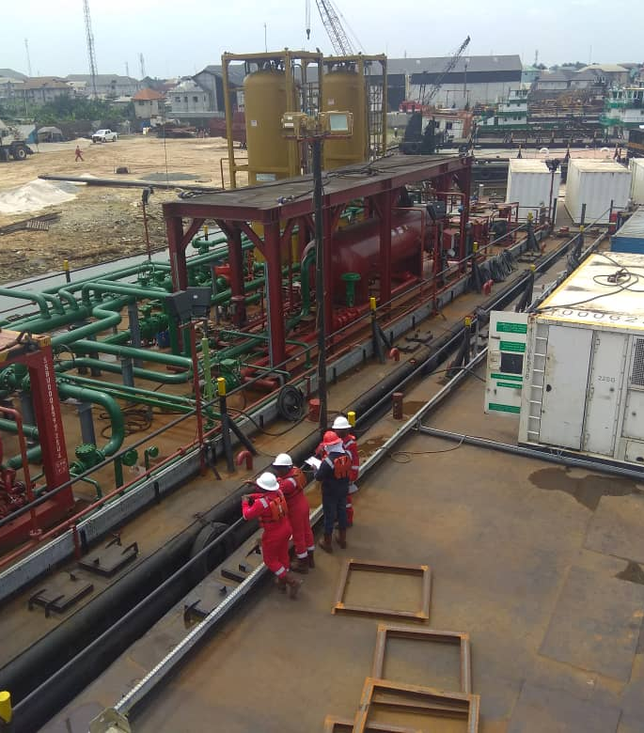
VGA INTEGRATED
PROJECT SOLUTIONS
VGA INTEGRATED

Slide 2
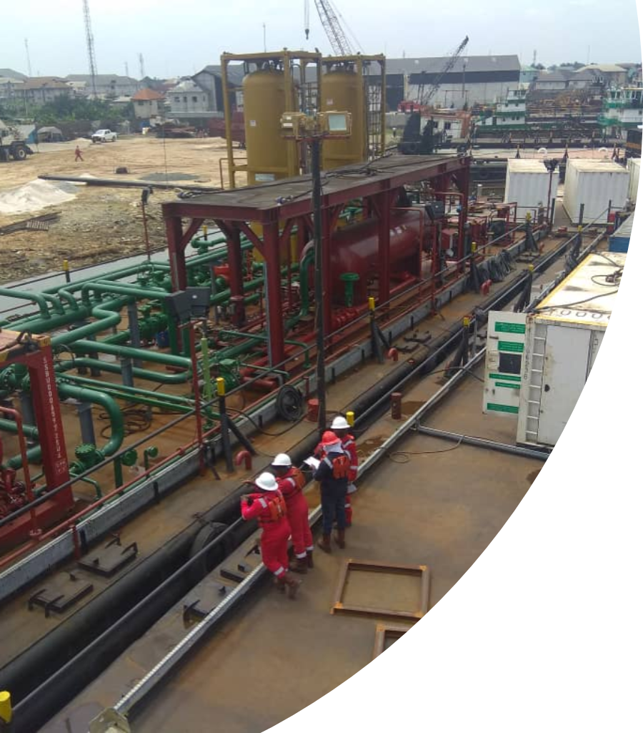
WHO WE ARE
VGA INTEGRATED
Is a specialized Innovative Company offering quality solutions and Inspection Services to Clients across. Services include:
Project Management,
EPC for Civil, Electrical, Instrument , Mechanical
Marine Engineering and Under water services including diving
Oil and Gas Engineering Consultancy Solutions
Quality Control & Assurance Services onshore and foreign covering design, procurement and Construction
Dewatering Brage
EPF

Slide 3

Vga integrated
Established to provide Engineering solutions to the oil & gas energy sectors
Independent technical, commissioning, construction and project management consultancy
In-house specialist recruitment with capable Nigerian and Foreign partners
5Blue Process equipment Inc.
Edmonton Canada
9Angle west Africa

Slide 4

VGA INTEGRATED

Slide 5
Vga intEgrated
5Blue CORPORATE OVERVIEW
5Blue Process Equipment Inc. provides the oil and gas processing industry with high quality, custom engineered products worldwide. Focused on client performance, our team thrives on adding value by designing innovative solutions to meet technical and operational challenges. With a combined 200+ years of experience, our team of experts provides solutions for a diverse group of clients ranging from start-ups to the largest oil and gas corporations globally.
5Blue is committed to providing high quality products and services that are custom built to meet clients' specifications in a practical and functional lifecycle application, considering stringent environmental regulations and targeting zero-loss incidents. 5Blue offers comprehensive packages: from initial concept, design, engineering, manufacturing, transportation, installation and commissioning, to start-up and operator training. From the initial concept to the operational product, our in-house design and engineering group strives to produce a system that is reliable, safe, efficient, and easily maintained and provides an appropriate solution to our client’s specific control and processing needs.
Located
5 kilometers from the Edmonton International Airport, 5Blue has direct access to road, rail and air transportation. We have well established working relationships with a number of logistics companies capable of delivering our product anywhere in the world. Ocean transportation is available through the ports of Vancouver, Montreal and Houston.
We constantly strive for excellence in our services and products

Slide 6
VGA INTEGRATED

Slide 7

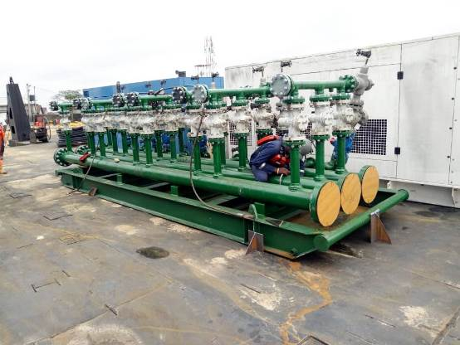
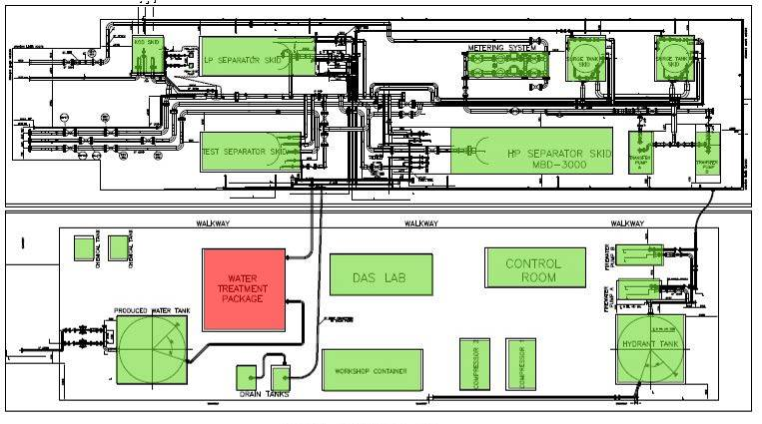


EARLY PRODUCTION FACILITY (EPF)
Early Production Facility (EPF)
  Completed onshore activities and sailed the EPF barge on June 26, 2019.
  ETA to Gbetiokun site to commence integration with Gbetiokun facilities- July 03,2019
  Piping fabrication and integration is 100% complete
  Valves testing and integration is 100% complete
  Inlet manifold and Metering skid integration is 100% complete
Assembled Inlet Manifold
EPF Layout
EPF Piping Integration Complete

Slide 8
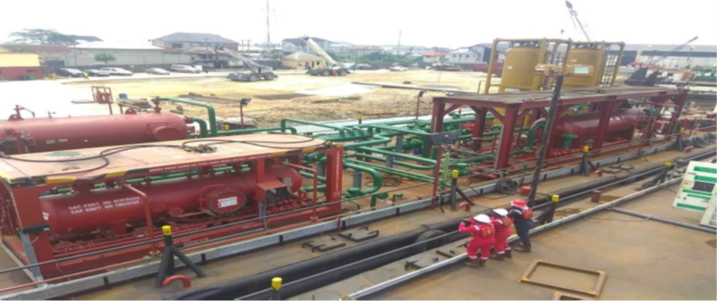
VGA INTEGRATED

Slide 9
VGA INTEGRATED

Slide 10
VGA INTEGRATED
9Angle PHC

Slide 11
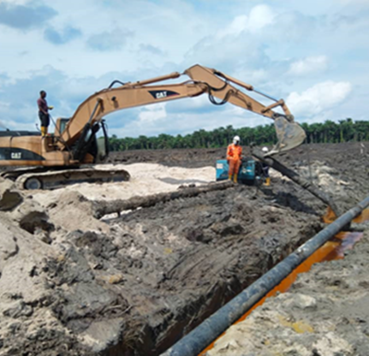
VGA INTEGRATED
Key Specialized areas
Onshore/ Offshore Production and evacuation systems
Debottlenecking and Facility Safety upgrading
Early Production Facility (EPF)
Dewatering Facilities / Water processing
Well Head Platforms and flowlines
Pipeline construction
Products gathering and distribution system
Hook-up, fabrication and installation
Project Management and Project Solutions
Oil and Gas Consultancy & Marine

Slide 12
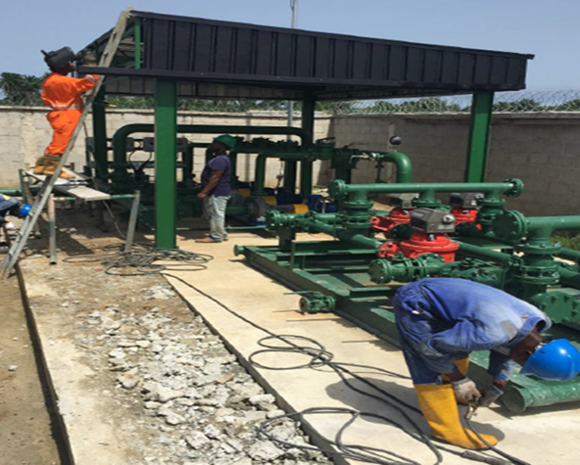
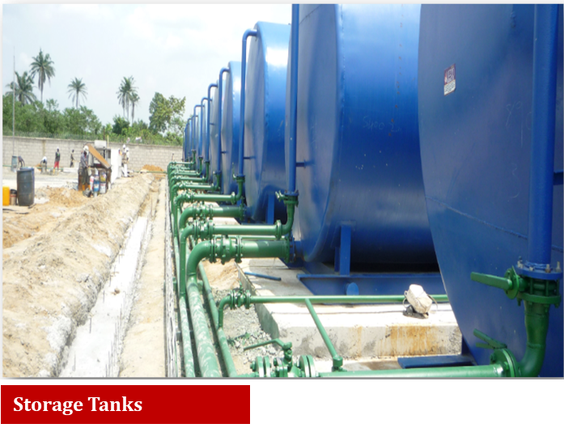
VGA INTEGRATED

Slide 13
VGA INTEGRATED- PROJECT EXPERIENCE
4 ELCREST E & P NIG. LTD.
THROUGH HALLIBURTON
ENERGY SERVICE NIG.
LTD.
DESIGN, CONSTRUCTION AND
FABRICATION OF GBETIOKUN
FLOW STATION – OML 40
ENGINEERING DESIGN, WORKSHOP PREFABRICATION,
SITE INSTALLATION OF 3KPSI WP
METERING SKID, 5KPSI INLET MANIFOLD AND
INTEGRATION OF INTERCONNECTING PIPING
AUGUST 2019
COMPLETED
5 HALLIBURTON ENERGY
SERVICE NIG. LTD.
DESIGN & FABRICATION OF 6 NOS
1050 CUFT PRESSURE VESSEL
(SILOS)
FABRICATION OF 6 UNITS PRESSURE VESSELS
(SILOS) FOR CEMENTING
FEBRUARY 2019
COMPLETED
6 SHELL PETROLEUM
DEVELOPMENT
COMPANY (SPDC)
FABRICATION OF OTUMARA
DOMGAS ACCOMODATION
MODULE
CONSTRUCTION, FABRICATION & FURNISHING
OF 13 UNITS 4-MAN ACCOMODATION MODULE
(PORTAKABIN) FOR SPDC OTUMARA LOCATION
DECEMBER 2018
COMPLETED
HALLIBURTON ENERGY
SERVICE NIG. LTD.
DESIGN & FABRICATION OF 5”
MUD LINE STAND PIPE
ENGINEERING DESIGN AND WORKSHOP PREFABRICATION
OF 5” MUD LINE STAND PIPE
DECEMBER 2019
ON-GOING
2 HALLIBURTON ENERGY
SERVICE NIG. LTD.
DESIGN AND FABRICATION OF
EXPLOSIVE MAGAZINES
DESIGN, CONSTRUCTION AND FABRICATION OF
8 NOS EXPLOSIVE MAGAZINES APPROVED BY
MINISTRY OF MINES & STEEL DEVELOPMENT
DECEMBER 2019
ONGOING
3 HALLIBURTON ENERGY
SERVICE NIG. LTD.
DESIGN & FABRICATION OF DNV GL
CERTIFIED MINI CONTAINERS
FABRICATION OF 10 NOS DNV GL CERTIFIED
MINI CONTAINERS
OCTOBER 2019
ONGOING

Slide 14
VGA INTEGRATED-PROJECT EXPERIENCE
Natural Gas Dehydration
Bangladesh Bibiyana Project - TEG Dehydration..................................................................................................(4) x 150 MMSCFD (each)
Bangladesh MB Project - TEG Dehydration.............................................................................................................................110 MMSCFD
Bangladesh - TEG Dehydration................................................................................................................................................150 MMSCFD
Liard Dehydration Station..........................................................................................................................................................75 MMSCFD
Cabin Lake Gas Plant...............................................................................................................................................................200 MMSCFD
Carmon Creek - Dehydration Unit (Acid Gas)...........................................................................................................................2.8 MMSCFD
Weyburn CO2 Capture-Molecular Sieve...........................................................................................................................2 - 4’ x 30’ Towers
Old Man Gas Plant Molecular Sieve Package...................................................................................................................3 – 5’ x 24’ Tower
Metering Units
Sales Gas/Condensate Metering Package...................................................................................................................80 MMSCFD CL 1500
Sales Gas Meter Package.............................................................................................................................................100 MMSCFD CL 600
Kiwigana-Sales Metering Package................................................................................................................................30 MMSCFD CL 2500
Blair Creek Gas Plant, Sales Gas Metering Package.......................................................................................................50 MMSCFD CL 600
Natural Gas And Liquid H2S And CO2 Removal
Oman - Amine Sweetening......................................................................................................................................150 gpm, 100 MMSCFD
Northern Alberta - Amine Sweetening.........................................................................................................................110 gpm, 80 MSCFD
US - Amine Sweetening.............................................................................................................................................600 gpm, 90 MMSCFD
Pakistan - Amine Sweetening Package Block 22.........................................................................................................45 gpm, 20 MMSCFD
Birch Compressor Station - Amine Sweetening........................................................................................................5.5 gpm, 2.2 MMSCFD
Cabin Lake Gas Plant - Amine Sweetening............................................................................................................2200 gpm, 200 MMSCFD
Northern Alberta - Liquid C3+ Amine Sweetening.........................................................................................................................535 gpm
Northern Alberta - Liquid C3+ Amine Sweetening...........................................................................................................................60 gpm

Slide 15
VGA INTEGRATED- PROJECT EXPERIENCE
Fractionation, Stabilization, Dew Point Control & NGL Recovery
Northern B.C. - De-Butanizer Package..........................................................................................................................................7,000 BPD
LPG Recovery Project, Indonesia - Turbo Expander..........................................................................................66 MMSCFD, 650 BPD Cond
..............................................................................................................................................................................................230 MT/D LPG
Abu Tubul - Refrigeration Plant and Stabilization..............................................................................................90 MMSCFD and 8000 BPD
Pakistan - TEG Dehydration, HCDP & Condensate Stab................................................................................150 MMSCFD, 3000 BPD Cond
Indonesia-Mechanical Refrigeration, LPG Recovery.......................................................................................60 MMSCFD, 350 BPD Cond
...............................................................................................................................................................................................1200 BPD LPG
Pakistan - Mechanical Refrigeration.............................................................................................................150 MMSCFD, 3000 BPD Cond
Egypt - Turbo Expander, LPG Recovery.........................................................................................................160 MMSCFD, 5000 BPD Cond
...............................................................................................................................................................................................3000 BPD LPG
Ecuador - Tarapoa Facility, HCDP and Frac Train..............................................................................................................80,000 BPD (Feed)
Pakistan - Zamzama EWT HCDP Unit and Dehy ....................................................................................................................70.0 MMSCFD
Lator Gas Plant- De-Ethanizer & Stabilizer Exp ...................................................................................................4500 BPD Cond 2500 BPD
Kaybob Gas Plant Phase 2 - Condensate Stabilizers.................................................................................................5000 BPD, (two trains)
Kaybob Gas Plant Phase 1 - Condensate Stabilizers......................................................................................................................5000 BPD
Simonette Gas Plant - Condensate Stabilizers................................................................................................................................5000 BPD
Separation Systems
Saskatchewan - FWKO Package ...............................................................................................................144" ID x 80'-0" S/S, (four trains)
Saskatchewan - Treater Package.....................................................................................................................................144” ID x 70-0” S/S
Ferrier Gas Plant - Oil Treater &FWKO ..........................................................................................................................................5500 BPD
Saskatchewan - FWKO Package ..................................................................................................................................120” OD x 50’-0” S/S
Saskatchewan - FWKO Package ....................................................................................................................................120” ID x 40’-0” S/S

Slide 16
VGA INTEGRATED
Thank You
QUESTIONS?

